Slide 1
Using Sentinel Policies Across Multiple Terraform Cloud Organizations
Roger Berlind
Sr. Solutions Engineer, HashiCorp
Email: roger@hashicorp.com
Notes:
Who I am.
I work with most of our products but am a specialist in Terraform, Nomad, and especially Sentinel
In fact, I've written many of the sample policies in HashiCorp's terraform-guides GitHub repository
and I wrote a comprehensive guide on the writing and testing of Terraform Sentinel policies.

Slide 2
Objectives
The primary objective of this session is to show how Sentinel policies can easily be used across multiple Terraform Cloud (TFC) organizations by leveraging TFC's VCS integrations and Policy Sets.
A secondary objective is to show how GitHub Actions can be used to automatically run Sentinel Simulator test cases against policies modified in pull requests.
Notes:
Objectives

Slide 3
Benefits of Storing Policies in VCS
All the standard VCS benefits including version history, change control, and collaboration
+
Sharing policies across multiple TFC organizations without having to edit them multiple times
Ensuring modified policies pass your Sentinel Simulator test cases before they are merged
Notes:
What are the benefits of storing your policies in VCS repos?

Slide 4
Agenda
What is Sentinel?
How is Sentinel Used in Terraform?
Managing Sentinel Policies Across Multiple Organizations
Demo
Notes:
I'll start out by talking about Sentinel, then talk about how it is used in Terraform.
I'll then talk about how you can manage Sentinel policiees across multiple organizations.
I'll then give a demo that shows this.

Slide 5
What is Sentinel and How is It Used in Terraform?
Notes:
Now let's talk about Sentinel and how it is used in Terraform

Slide 6
What is Sentinel?
HashiCorp's Sentinel is a framework for implementing governance policies as code in the same way that Terraform implements infrastructure as code.
It includes its own language and is embedded in HashiCorp's enterprise products.
Using Sentinel ensures that your governance policies are actually being checked rather than just being listed in a spreadsheet.
It supports fine-grained policies that use conditional logic.
It includes a Simulator that allows you to test policies.
Notes:
Sentinel is a framework for governance as code just like Terraform implements infrastructure as code.

Slide 7
How is Sentinel Used in Terraform?
Sentinel Policies are checked between the standard Plan and Apply steps of runs in Terraform Cloud (TFC) and Terraform Enterprise (TFE).
Policies have different enforcement levels.
Violations prevent runs from being applied unless a user with sufficient authority overrides them.
Sentinel policies can evaluate the attributes of existing and new resources based on information associated with the current run:
the plan, the configuration, the current state, and other run data
This ensures that resources comply with all policies before they are provisioned.
Notes:
Enforcement levels are advisory, soft-mandatory, and hard-mandatory
Sentinel policies are checked between the plan and apply steps of runs in in TFC and TFE.

Slide 8

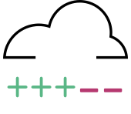


VCS
Terraform
Cloud
Workspace
plan
Sentinel
Policy Checks
apply
Infrastructure
Note that if cost estimates are enabled, they run right after the plan.
Notes:
We see here that Sentinel policy checks occur between the plan and apply steps of a Terraform Cloud run.
Terraform code is typically loaded into a Terraform Cloud workspace from a VCS repository
A plan is run against the code.
Then Sentinel policy checks are run against the data provided by the plan and workspace.
If the checks all pass or failures are overridden, an apply can be done to provision infrastructure.

Slide 9
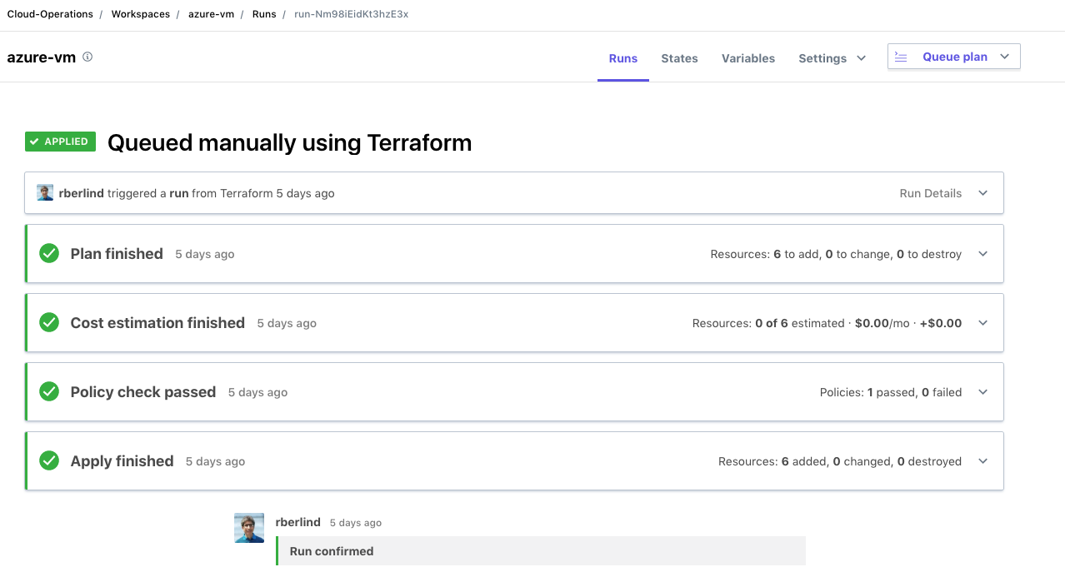
Notes:
This screenshot of a run in the TFC UI also shows that Sentinel policy checks occur between the plan and apply steps of a Terraform Cloud run.
But it adds in the new Cost Estimation step that is done after the plan if cost estimates are enabled in the organization.
This allows Sentinel policies to check the cost estimate data.

Slide 10
Sentinel Imports in Terraform
Sentinel includes several standard imports.
Terraform adds some additional imports:
The tfplan import gives access to the Terraform plan used by the current run.
The tfconfig import gives access to the Terraform configuration (the Terraform code) used by the current run.
The tfstate import gives access to the current state of the workspace of the current run.
The tfrun import gives access to workspace and cost estimate data of the current run.
Mocks corresponding to these 4 imports can be generated from TFC Plans for use with the Sentinel Simulator.
Notes:
Sentinel includes several standard imports available across all HashiCorp solutions that use Sentinel.
These include imports for working with strings and JSON documents as well as other data types
Terraform adds some additional imports to expand the capabilities of Sentinel.
Mocks can be generated from TFC plans to enable testing of Terraform Sentinel policies with the Sentinel Simulator

Slide 11
Managing Sentinel Policies Across Multiple TFC Organizations
Notes:
I would now like to discuss how Sentinel Policies can be managed across multiple Terraform Cloud organizations.

Slide 12
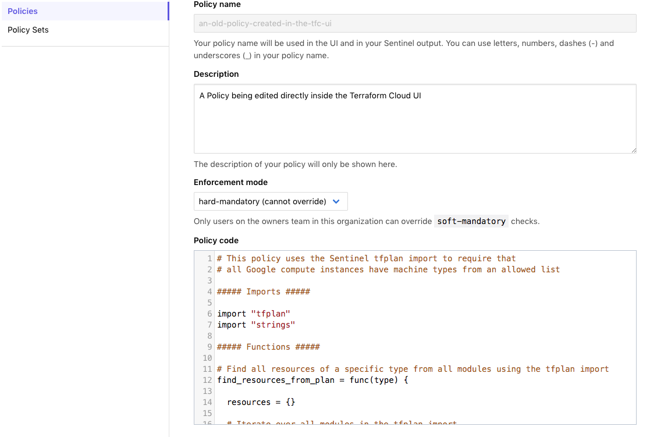
The Old Way of Managing Policies
In the past, Sentinel policies were created in the TFC UI itself
Code had to be typed or pasted into this small window

Slide 13
The New and Better Way
At the end of 2018, Policy Sets were added to Terraform Cloud.
They allowed groups of policies to be selectively applied to workspaces in an organization.
But they still used the policies edited within the TFC UI.
A few months ago, VCS-Enabled Policy Sets were added to TFC.
Now, instead of pasting policies into the TFC UI, you point your policy sets against VCS repositories.
You can also specify the VCS branch and policies path.
This gives better versioning of policies and enables the same policies to be used across multiple TFC organizations.

Slide 14
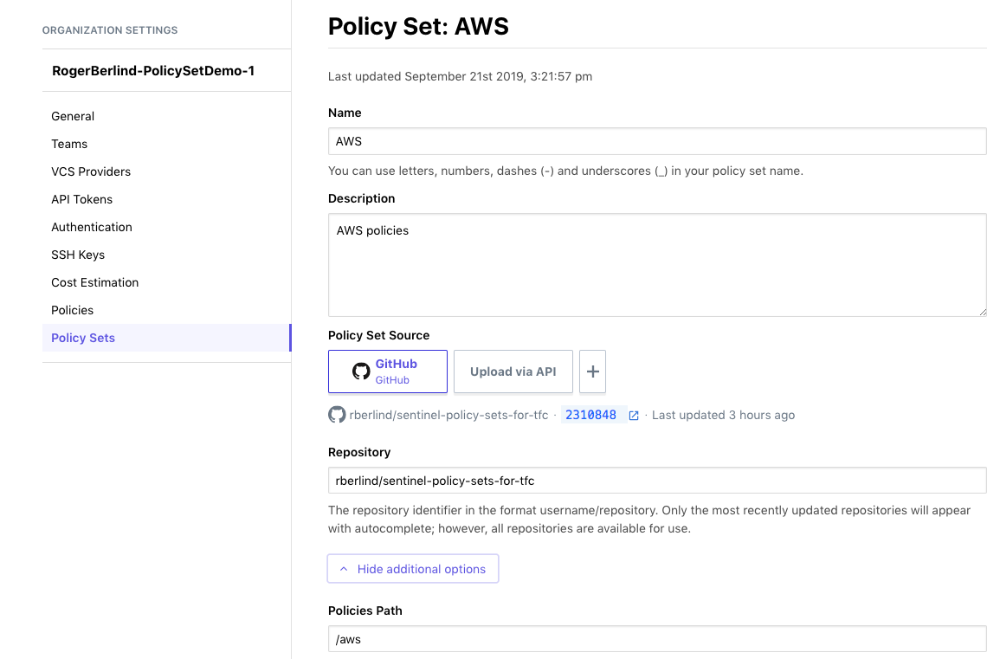

Slide 15
Demo All required artifacts are in these repositories: Terraform code: https://github.com/rberlind/se-hangout-9-25-2019 Sentinel Policy Sets and Policies https://github.com/rberlind/sentinel-policy-sets-for-tfc
Notes:
Now, I'll do a demo that illustrates using the same policies across 2 TFC organizations.
I'll also show how GitHub Actions can be used to trigger tests with the Sentinel Simulator
when pull requests are made.

Slide 16
Demo of Sentinel Policy Sets and Policies
Show how policies stored in a GitHub repository can be shared across two Terraform Cloud organizations.
Show how the Sentinel policies restrict provisioning of VMs.
Show how changing a policy in the GitHub repository automatically updates the version of it that both organizations use.
Show how doing a pull request against the master branch triggers one or more GitHub Actions to run Sentinel Simulator test cases.
Note that test cases are only run against policy sets that had changes.
Notes:
Here is what I will show you during the demo

Slide 17
Additional Useful Links
Sentinel Docs:
https://docs.hashicorp.com/sentinel
Terraform Sentinel Docs:
https://www.terraform.io/docs/cloud/sentinel/index.html
GitHub Repository with Sample Terraform Sentinel Policies for AWS, Azure, GCP, and VMware:
https://github.com/hashicorp/terraform-guides/tree/master/governance
My Guide for Writing and Testing Sentinel Policies for Terraform:
https://www.hashicorp.com/resources/writing-and-testing-sentinel-policies-for-terraform
My HashiConf 2019 Presentation about testing Terraform Sentinel Policies with Generated Mocks:
https://github.com/rberlind/HashiConf-2019
Notes:
Here are some additional useful links.

Slide 18
Using Sentinel Policies Across Multiple Terraform Cloud Organizations
Roger Berlind
Sr. Solutions Engineer, HashiCorp
Email: roger@hashicorp.com
Notes:
Thanks for attending this webinar.
I hope you found it interesting and useful.
Now, I'll be happy to answer your questions for the next 15 minutes.

